Slide 1

World Airbnb
Hawaii
Data Sciences Team
Armon Kohan
Edith Jimenez
Lance Westlake
Meg Peterson
Scott Whigham

Slide 2

Content
Introduction
Project Description
Data Analysis:
Preparation
Validation
Clean
Hypothesis
Questions
Technical Analysis
Results
Conclusions

Slide 3

What Makes an Airbnb Rental Property “Successful” ……… in Hawaii?

Slide 4

Project Description
Airbnb Rental Property in Hawaii
Scope:
Analyze the attributes that characterize Airbnb and make it successful. The analysis is focus on Hawaii
Methodology:
Test the hypothesis raised during the data analysis
Elaborate questions to test the hypothesis
Develop visual support to interpret the data
Carry out statistical tests to validate the relationship between the variables

Slide 5

Data Source
Data source: The “Inside Airbnb” Project
http://insideairbnb.com/get-the-data.html
Data published under Creative Commons CC0 1.0 Universal (CC0 1.0) "Public Domain Dedication" license.
From insideairbnb.com’s disclaimers:
The data utilizes public information compiled from the Airbnb web-site … and the reviews for each listing.
No "private" information is being used. Names, photographs, listings and review details are all publicly displayed on the Airbnb site.
Data is verified, cleansed, analyzed and aggregated

Slide 6

Data Preparation
Process:
Organize the column to make easy the analysis
Build data frame to group columns
Create a group by neighborhood and number of reviews
Create bin to separate by number of reviews

Slide 7

Data Validation
Validation Process:
Create figure to visualize the behavior using Seaborn and Matplotlib libraries
Neighborhood groups vs number of reviews
Neighborhood groups vs Price
Review score cleanliness vs Review score rating
Review score values and review score rating

Slide 8
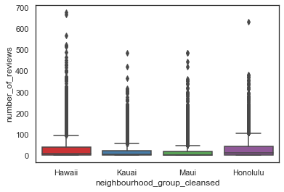
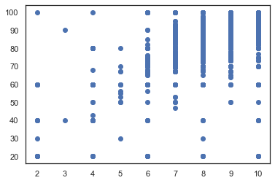
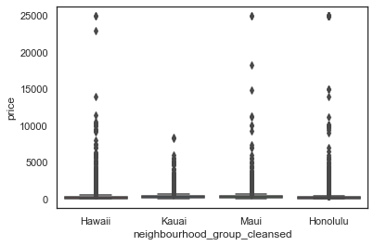
Data Validation Visual
Neighborhood groups vs number of reviews
Review score cleanliness
Vs
Review score rating
Neighborhood groups vs Price

Slide 9
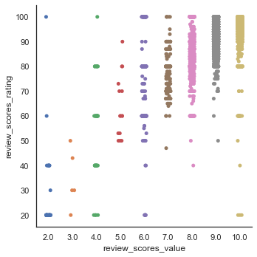
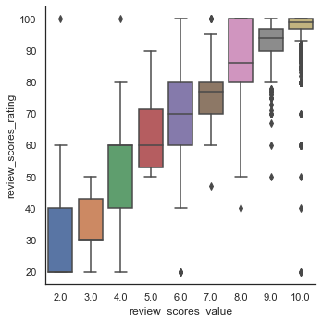
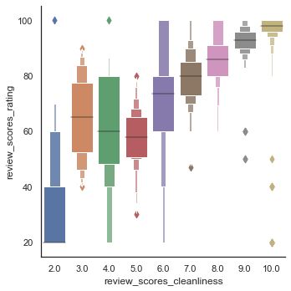
Data Validation Visual
Review score values
and
Review score rating
Review score value
and
Review score rating
Review score cleanliness
and
Review score rating

Slide 10
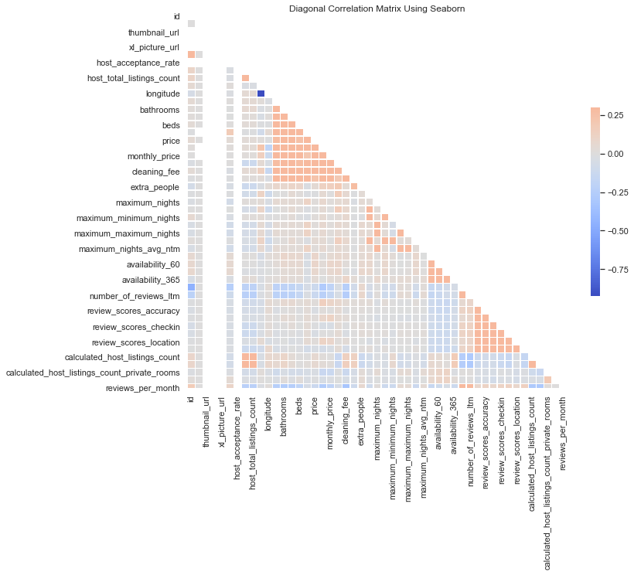
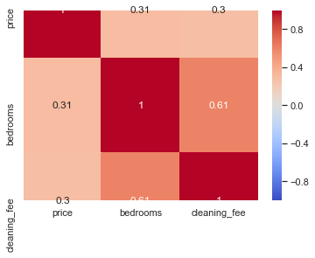
Data Validation Visual
Correlation Matrix

Slide 11

Data Clean
Cleaning Process:
Cleaning raw data to drop:
Columns with not values.
Columns with values duplicated on another column.
Columns with data are not relevant.
On the column “number of reviews” remove the rows that have value equal to zero (0)
Strip the dollar symbol ($) out of the pricing based columns:
"price",
"weekly_price",
"monthly_price",
"security_deposit",
"cleaning_fee",
"extra_people"
Strip the dollar symbol ($) out of the pricing based columns:

Slide 12
Hypothesis
Ho:
There are certain factors that have an impact on the overall rating of an Airbnb property.
H1:
None of the factors that we are analyzing have any impact on the overall rating of a property.

Slide 13
Questions
What is the relationship between:
Price and overall rating of property?
Number of properties per host and ratings?
Number of bedrooms and rating of property?
Neighborhood and overall rating of property?
Type of room and rating of property?
Island location and rating of property?

Slide 14
Analysis
Variables that have an effect on the rating.
Neighborhood
Price
Number of beds
Number of properties
Island location
Room accommodation type

Slide 15
Average Rating per Number of Properties

Slide 16
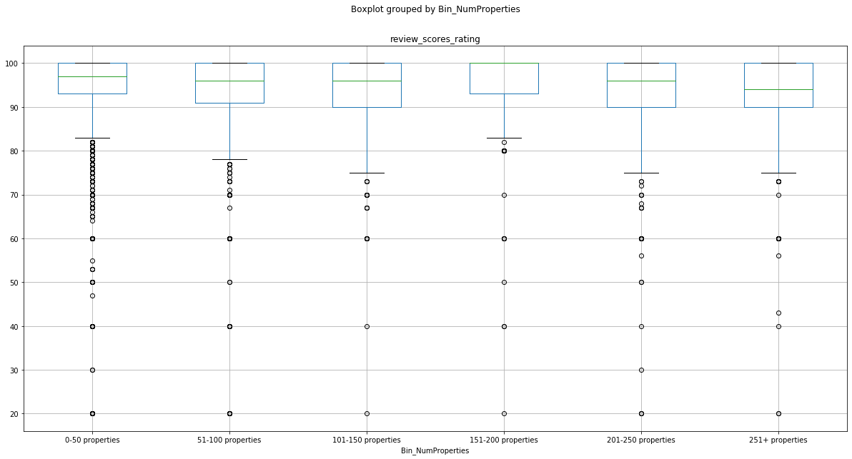
The p value is 1.9870577727779467e-44 and therefore we can reject our null hypothesis and say that
the number of properties owned by a host does have an impact on the overall rating.
Average Rating per Number of Properties
Notes:
pvalue=1.9870577727779467e-44

Slide 17
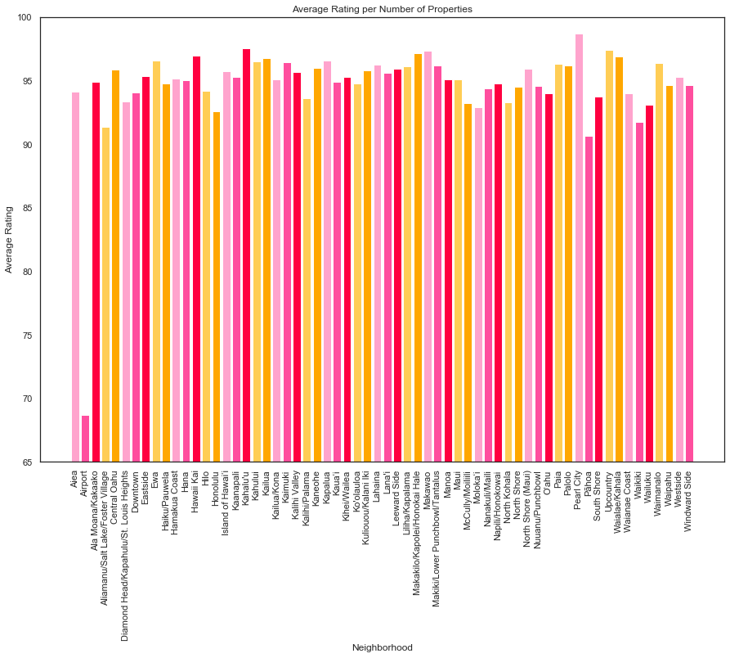
There is a difference in rating between the different neighborhoods.
The neighborhood with the highest average property rating is “Pearl City”, and the one with the lowest is the area surrounding the “airport”.
Average Rating for each Neighborhood

Slide 18
The p value is 0.0642994511972585 and we can accept our null hypothesis and say that the number of properties owned by a host does not have an impact on the overall rating.
Average Rating per Number of Beds
Notes:
pvalue=0.0642994511972585

Slide 19
The r-squared is: 0.018787686050668887 and therefore accept the null hypothesis and
say that the price of a property does not have an impact on the overall rating.
Average Rating vs Price
Notes:
r-squared is: 0.018787686050668887

Slide 20
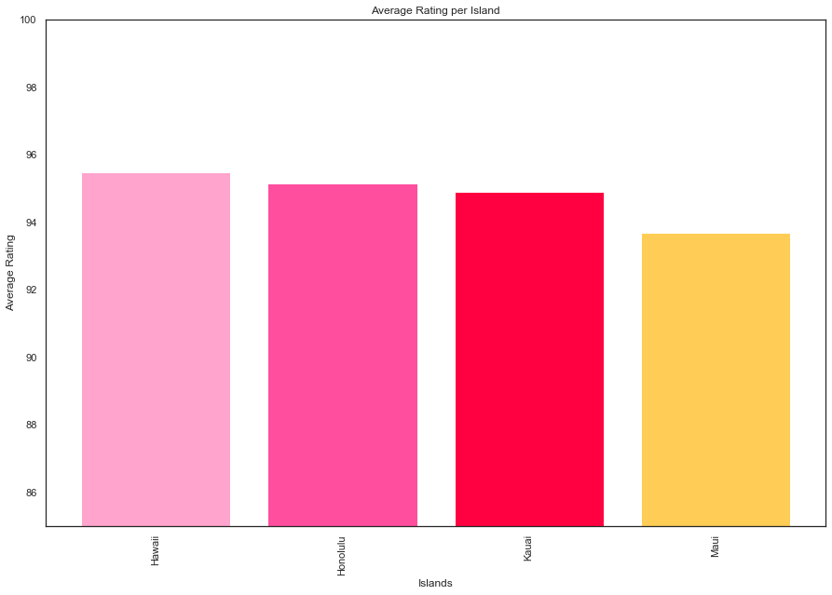
Average Rating per Island

Slide 21
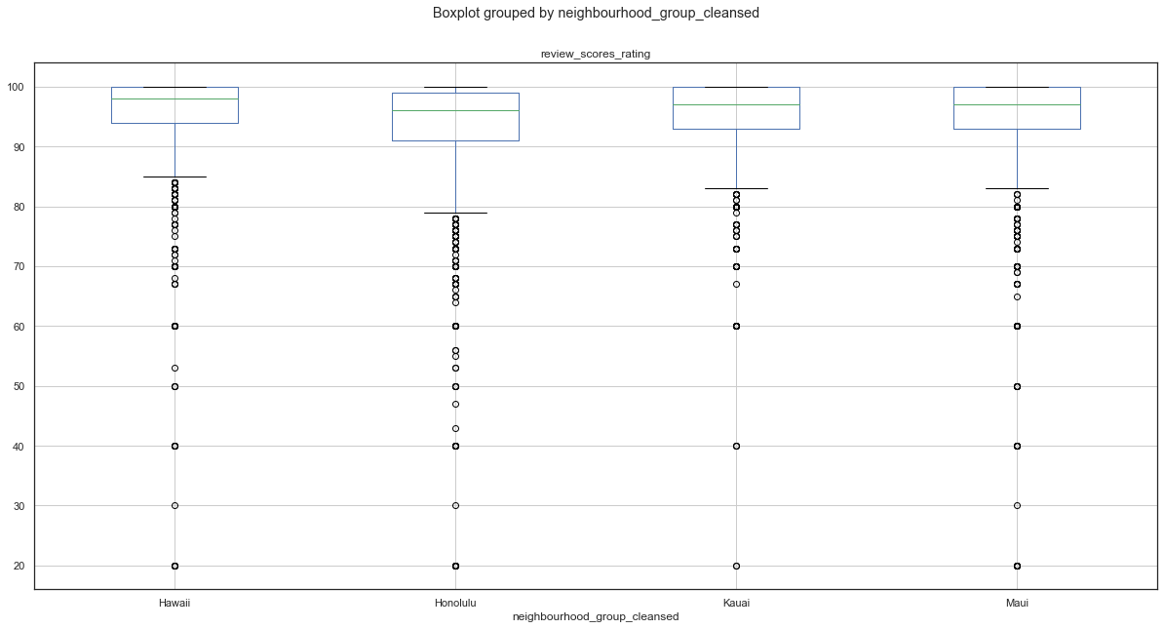
P value = 2.089378008602952e-37 is less than 0.05 and
therefore statistically significant and can reject the null hypothesis.
Average Rating per Island

Slide 22
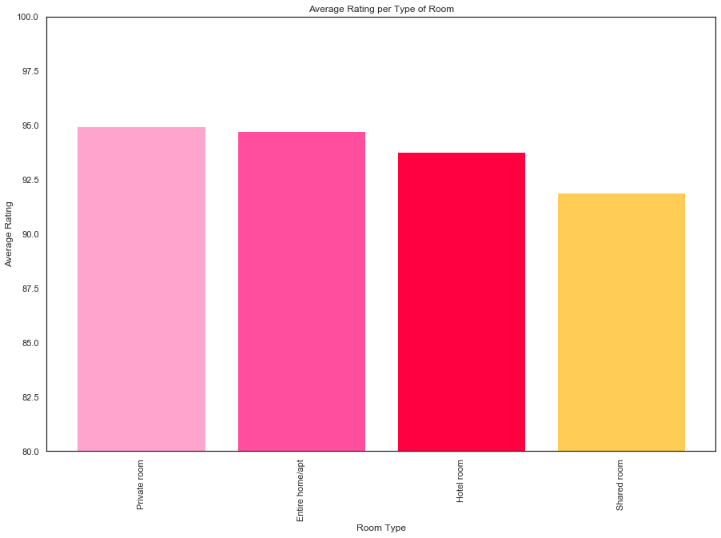
Average Rating per Room Type

Slide 23
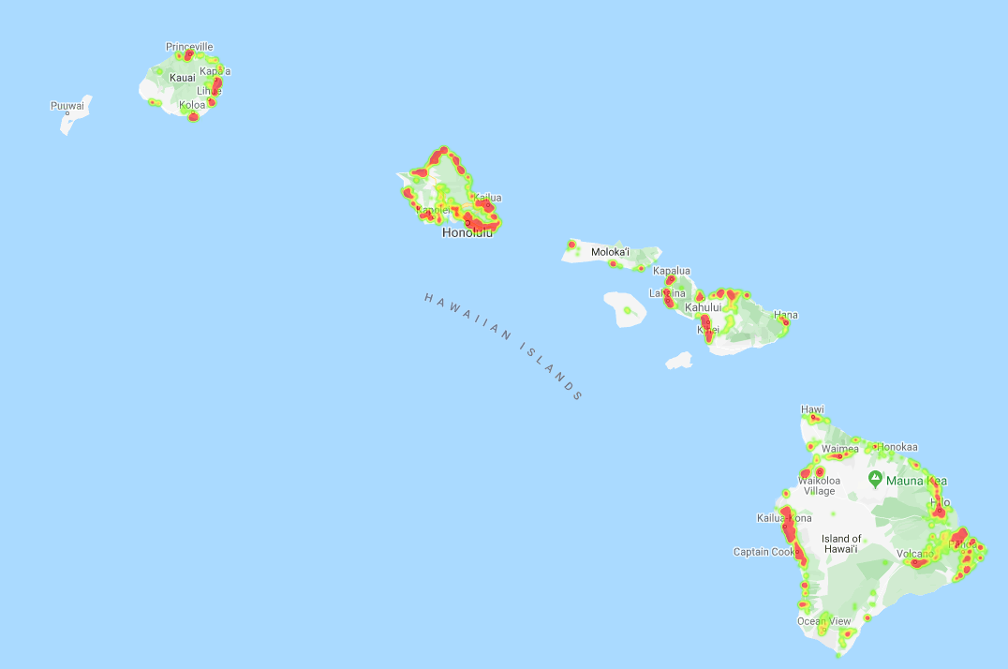
Properties Rated by Value Score

Slide 24
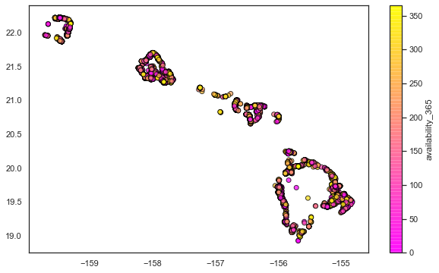
Properties Availability Over 365 Days

Slide 25
Results
The number of properties owned by a host does impact the overall rating.
The number of bedrooms does not have an impact on rating.
The neighborhood of the property does have an affect on the rating.
The price of a property does not have a correlation to the rating of the property.
The island that the property is on does appear to have an affect on the average rating.
The island that the property is on does appear to have an affect on the average rating.
There are slightly higher ratings on average for private rooms and entire homes than hotel rooms and shared rooms.

Slide 26
Conclusions
Ho:
There are certain factors that have an impact on the overall rating of an Airbnb property.
H1:
None of the factors that we are analyzing have any impact on the overall rating of a property.
Neighborhood of the property
Island that the property is on
Number of properties owned by a host
Number of bedrooms
Price of a property

Slide 27

Questions and Answers

Slide 28






Thanks
For your attention
Team Walking-In-Paris

Slide 29
The Scam
Critical Inside

